Slide 1
_{INTRODUCTION}
_{TO}
_{STUDENT}
_{FINANCE}
Notes:
An introduction to student finance covering eligibility for financial support, the range of funding available, applications, repayments and money management.
The presentation is designed to last 25-35 minutes. Not all slides need to be used; you can remove slides to make the presentation appropriate for your audience.
Students and their parents/partners can find out more about student finance, and all the topics covered in this presentation on Student Finance England’s official student finance zone on The Student Room at www.thestudentroom.co.uk/studentfinance or on Gov.UK at www.gov.uk/studentfinance
There is more information available for practitioners, including factsheets and policy information, on our practitioner website at www.practitioners.slc.co.uk

Slide 2
i
STUDENT FINANCE ENGLAND
AN INTRODUCTION
Student Finance England (SFE) provides financial support on behalf of
the UK Government to students from England entering higher education
in the UK.
The two main costs you’ll have while studying are tuition fees and
living costs.
There’s student finance available to help students with both*.
Depending on your circumstances, course and where you study,
you may be able to get a range of financial help and support.
i
*Full-time students only - part-time students can get tuition fee and
DSA support from SFE.

Slide 3
i
SESSION CONTENTS
Section 1 – What support can you get?
Section 2 – How do you get it?
Section 3 – When & how do you repay it?
Section 4 - Managing your money

Slide 4
SECTION 1
WHAT SUPPORT CAN YOU GET?
FEES, LOANS & EXTRA HELP*
*All figures based on AY 2017/18

Slide 5
TUITION FEE Loan
Extra support
SECTION 3
SECTION TITLE IN HERE
SUBHEADER IN HERE
What support can you get?
Maintenance
Loan

Slide 6
HOW MUCH DO YOU KNOW?
TUITION FEES
Q
What’s the maximum tuition fee universities or colleges can currently charge new students*?
A
£9,250
Q
How much of this would you need to pay up front before going to uni or college*?
A
£0
*Eligible students, living in England and studying at a publicly-funded university or college.

Slide 7
TUITION FEES AND LOANS
AN OVERVIEW
With tuition fees of up to £9,250, how can you afford to go to uni?
Eligible students won’t have to pay any tuition fees up front.
A Tuition Fee Loan is available to cover the fee charged by your university
or college.*
A Tuition Fee Loan doesn’t depend on household income.
SFE pay the Tuition Fee Loan directly to your university or college.
The loan is repayable, but only when your income is over £21,000 a year.
i
*Up to £9,250 for full-time courses at a publicly-funded uni or college
or up to £6,165 for approved courses at private providers.

Slide 8
Tuition Fee Loan
Extra support
SECTION 3
SECTION TITLE IN HERE
SUBHEADER IN HERE
What support can you get?
MAINTENANCE
Loan

Slide 9
MAINTENANCE LOAN
AN OVERVIEW
A Maintenance Loan is available to help with your living costs while at uni or
college.
All eligible students can get some maintenance support.
The amount of Maintenance Loan you can get depends on where you
live and study.
The Maintenance Loan is paid directly into your bank account each term.
Maintenance Loans have to be paid back but not until you’ve finished or left your course and your income is over £21,000 a year.

Slide 10
MAINTENANCE LOAN
MAXIMUM LEVELS FOR 2017/18
0
Parental home
Live at home while you study
Up to
£7,097
£
Up to
£8,430
Elsewhere
Live away from home & study outside London
£
London
Live away from home & study in London
Up to
£11,002
i
If studying overseas as part of a UK course, Maintenance Loan support is still available, up to £9,654 for 2017/18.

Slide 11
Tuition Fee Loan
EXTRA support
SECTION 3
SECTION TITLE IN HERE
SUBHEADER IN HERE
What support can you get?
Maintenance
Loan

Slide 12
EXTRA SUPPORT
BURSARIES AND SCHOLARSHIPS
Many universities and colleges offer financial support to their students
through bursaries and scholarships.
Bursaries:
linked to personal circumstances and, often, household income
awards can include discounted tuition fees, accommodation or cash
Scholarships:
linked to academic results or ability in an area such as sport or music
can be subject specific and are usually limited in numbers
i
Check university/college websites and ask at open days to see
what they offer and how/when to apply....don’t miss out!!

Slide 13
ADDITIONAL SUPPORT
EXTRA SUPPORT
Other financial help and support may also be available if you:
have children or an adult depends on you
have a disability, including a long-term health condition, mental-health condition or specific learning difficulty
study a Social Work course
Notes:
Childcare Grant
Helps with childcare costs for dependent children aged under 15 at the beginning of the academic year (or under
17 if they have special educational needs) in registered or approved childcare. For more details on what childcare
qualifies, visit www.gov.uk/studentfinance
Parents’ Learning Allowance
This allowance can help with course-related costs for students with dependent children.
Adult Dependants’ Grant
The grant can help if a student has an adult who depends on them financially. This can’t be the student’s grown-up child or other adult who gets student finance.
Disabled Students’ Allowances (DSAs) help pay for extra costs a student might have as a direct result of their disability, including a long-term health condition, mental-health condition or specific learning difficulty, such as dyslexia or dyspraxia. DSAs are additional support available to students who may otherwise be prevented from attending university or college because of their disability.

Slide 14
SECTION 2
HOW DO YOU GET IT?
APPLICATIONS & INFORMATION

Slide 15
You APPLY online
You get PAID!
How do you get your student finance?
We ASSESS your
application

Slide 16
HOW MUCH DO YOU KNOW?
STUDENT FINANCE APPLICATIONS
Q
What is the easiest way to apply for your student finance?
a) Call SFE and ask for an application form to be sent to you
b) Online @ www.gov.uk/studentfinance
c) Apply? I just thought the money would appear when I need it!
a) After you have started your course
b) When you have a confirmed offer from a university or college
c) As soon as possible
A
b) Online @ www.gov.uk/studentfinance
Q
When should you apply for your student finance?
A
c) As soon as possible

Slide 17
STUDENT FINANCE APPLICATIONS
KEY MESSAGE – APPLY EARLY
Each year thousands of students apply late for their finance and have no
way to pay for their course or accommodation, some even have to drop out
...don’t let that be you!
Apply online at gov.uk/studentfinance*
Apply early to make sure your student finance is ready for the start
of your course.
You don’t need a confirmed place at university or college to apply.
Apply with your preferred choice, you can change details later if required.
i
*The application window is usually open from Jan-May. You can
register on UCAS for updates and information from SFE.

Slide 18
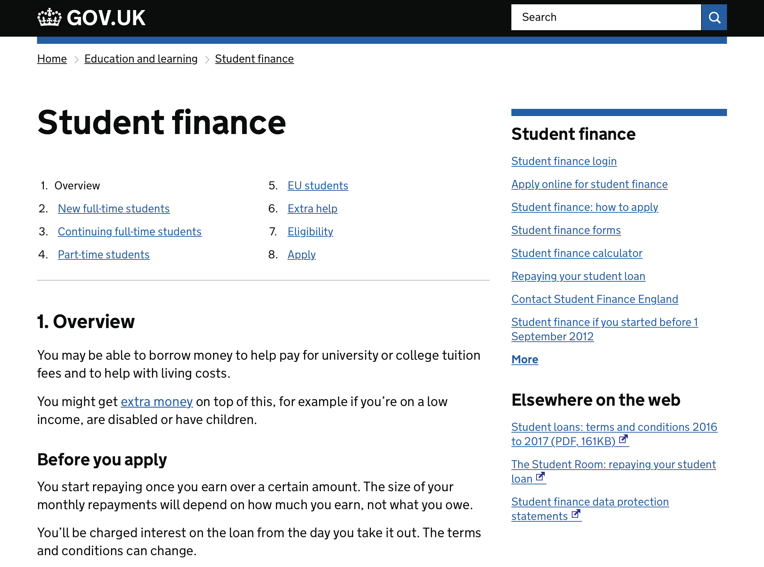
GOV.UK
FOR MORE INFORMATION AND TO APPLY
www.gov.uk/studentfinance
Notes:
Click image to link to page!

Slide 19
SFE ONLINE
FOR MORE INFORMATION AND RESOURCES
Notes:
Click image to link to page!

Slide 20
SUPPORTING AN APPLICATION
HOUSEHOLD INCOME
If you’re supporting an application for student finance that depends on
household income, SFE will need details of your taxable income and National
Insurance number.
If you’re the parent of a student and live with your partner, they’ll also have to
give us details of their taxable income and National Insurance number.
Taxable earned income includes*:
wages, salaries, tips, and other taxable employee pay
long-term disability benefits received prior to minimum retirement age
net earnings from self-employment
Taxable unearned income includes*:
interest from savings (only the annual summary is required)
benefits and pensions
rent from property or a room
i
*More details/information can be found on the HMRC website: https://www.gov.uk/income-tax
Notes:
This slide gives information for parents and partners of students who are supporting an application for student finance. You can skip this slide if you’re not presenting to parents/partners.

Slide 21
SECTION 3
HOW DO YOU REPAY YOUR
LOANS?
STUDENT LOAN REPAYMENTS

Slide 22
The FACTS
The INTEREST
SECTION 3
SECTION TITLE IN HERE
SUBHEADER IN HERE
How do
you repay
a student
loan?
The FIGURES

Slide 23
HOW MUCH DO YOU KNOW?
STUDENT LOAN REPAYMENTS
Q
What will your student loan repayments be based on?
a) Your future income
b) How much you have borrowed
c) Neither, you just pay a fixed amount regardless
a) £16,000 a year
b) £21,000 a year
c) Doesn’t matter, repayments will be taken whatever you earn
A
a) Your future income
Q
How much do you need to earn before you start to repay?
A
b) £21,000 a year

Slide 24
STUDENT LOAN REPAYMENTS
AN OVERVIEW
You won’t make repayments until your income is over £21,000 a year.
If you study a full-time course, you will be due to start repaying in the
April after graduating or leaving your course.
You’ll repay 9% of your income over £21,000 and if you’re employed deductions will be made from your pay through the HMRC tax system.*
If your income falls to £21,000 or below, your repayments will stop.
Any outstanding loan balance will be cancelled 30 years after entering repayment.
i
*If you move/work overseas you will repay 9% of your earnings
over the repayment threshold for the country you are living in.
Notes:
The current UK earnings threshold is:
£404 a week
£1,750 a month
£21,000 a year
Students who live or work overseas after they’ve finished their course still need to repay their loans. They’ll get more information about this towards the end of their course. For more information, visit www.slc.co.uk/repayment
The repayment threshold can change, for more information go to www.studentloanrepayment.co.uk

Slide 25
STUDENT LOAN REPAYMENTS
THE FIGURES
Income each year before tax | 9% will be deducted from | Monthly repayment (Approx)
£21,000 | £0 | £0
£22,000 | £1,000 | £7
£23,500 | £2,500 | £18
£27,000 | £6,000 | £45
£30,000 | £9,000 | £67
£4,000
Income
£25,000
9% Deducted from?
£30
Monthly
repayment?
i
Interest is applied to your loan at a maximum rate of RPI +3%
More info can be found on www.slc.co.uk/repayment
Notes:
Link to page is Live!
From example: a basic way of working out the monthly repayment would be to divide £4,000 by 12 giving £333.333 and that by 9% giving a monthly payment of £30.
You’re charged interest from the day your first payment is made until your loan is repaid in full or cancelled. The interest rate is based on the UK Retail Price Index (RPI) and will vary depending on your circumstances. For more information go to www.slc.co.uk/repayment
The Retail Price Index (RPI) is a measure of UK inflation. It measures changes to the cost of living in the UK.
The interest rate is updated once a year in September, using the rate of RPI from March.
Full-time student interest
While studying until entering repayment = RPI +3%
On entering repayment interest is linked to earnings
Under £21,000 = RPI Only
£21,000 to £41,000 = RPI + up to 3%
Over £41,000 = RPI + 3%
Part-time
While studying on a course until whichever comes first:
the April after graduating or leaving a course; or
the April four years after the start of a course = RPI + 3%
From the April after graduating or leaving a course, or the April four years after the start of a course - RPI

Slide 26
SECTION 4
MANAGING YOUR MONEY
MAKE SURE YOU ARE READY FOR HE

Slide 27
Consider the COSTS
Remember KEY POINTS
SECTION 3
SECTION TITLE IN HERE
SUBHEADER IN HERE
Make sure
you’re ready
for HE
Plan a BUDGET

Slide 28
MANAGING YOUR MONEY
CONSIDER THE COSTS
It’s important to think about the costs you are likely to face while at uni
and how to manage your money.
Remember, you’ll get a Maintenance Loan payment each term and
you’ll need to pay for things such as...
books and other study/course materials
accommodation, phone bill, food and drink
sports, leisure and social activities
i
There will also be costs you may not have thought of yet, such as insurance or a TV Licence...so think about planning a budget!

Slide 29
KEY MESSAGES
KEY POINTS TO REMEMBER
It’s important you make the right university/college and course choice.
Tuition Fee Loans are available to all eligible students.
Research all finance available – especially bursaries & scholarships.
Apply online & on time – no need to wait for a confirmed place.
And....
repayments will be linked to your income, not what you owe!
Notes:
Research all finance available – especially bursaries & scholarships (Tuition Fee Loans are available to all eligible students so no tuition fees should need to be paid upfront).
It’s important students make the right university/college and course choice based on course content and ‘feel for the uni’ rather than be swayed by cheaper fees.
Apply online & on time – no need to wait for a confirmed place.
Repayments depend on earning over £21,000 and are linked to the student’s income, not what they owe!
29

Slide 30
i
NEED MORE INFORMATION?
REMEMBER SFE IS ONLINE
For further information on student finance and applications go to
www.gov.uk/studentfinance
For a range of helpful tools and guidance,
visit our student finance zone
www.thestudentroom.co.uk/studentfinance
i
Notes:
Students and their parents/partners can find out more about student finance and all the topics covered in this presentation on Student Finance England’s official student finance zone on The Student Room - www.thestudentroom.co.uk/studentfinance - or on Gov.UK - www.gov.uk/studentfinance
Students and their parents or partners can also call SFE to discuss applications, eligibility or assessments on 0300 100 0607
There is more information available for practitioners, including factsheets and policy information, on our practitioner website, www.practitioners.slc.co.uk

